Slide 1
DESKTOP VISUALIZATION IN POWER BI By- GROUP 3

Slide 2
TOPICS
Desktop Visualization: Importance and Uses
Stacked Bar Chart
Stacked Column Chart
Cluster Bar Chart
Cluster Column Chart
100% Stacked Bar Chart
100% Stacked Column Chart
Summary

Slide 3
Importance Of Desktop Visualization
Data Exploration: Desktop visualization tools allow users to visually explore their data and gain insights quickly. By presenting data in visual formats such as charts, graphs, and maps, users can identify patterns, trends, and correlations that may not be apparent in raw data.
Data Integration: Desktop visualization tools often support integration with various data sources and formats, allowing users to bring together disparate data from multiple systems into unified visualizations. This capability enables users to gain a holistic view of their data and uncover meaningful insights that may exist across different data sources.
Data Communication: Visualizations are a powerful means of communicating data insights to stakeholders and decision-makers. Desktop visualization tools enable users to create visually appealing and interactive reports and dashboards that can be easily shared and understood by others. This facilitates effective communication and collaboration based on data-driven evidence.

Slide 4
Most common uses of Desktop Visualization
most common uses
Business performance reporting.
Project management and tracking.
Human resources analytics.
Customer analytics.
Risk analysis and compliance.
Financial analysis.
By- Poonam Bhagwat

Slide 5
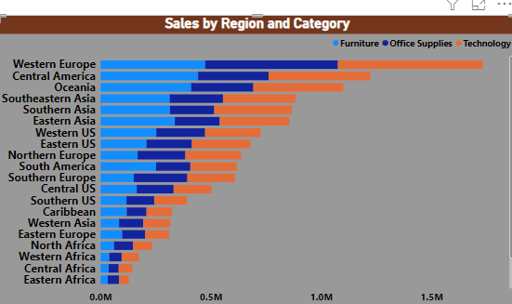
STACKED BAR CHART
Data Required: We need 2 types of data as below
1)Text Data
2)Numeric Data
About chart:
In this chart we can see the Sales of product by Region & Category wise
After completing the chart we can do different types of Formating such as:
Change the font size,colour,style etc ,
Change/add the background And
Add or remove Title, Data labels etc.
By: Harshal Patil

Slide 6
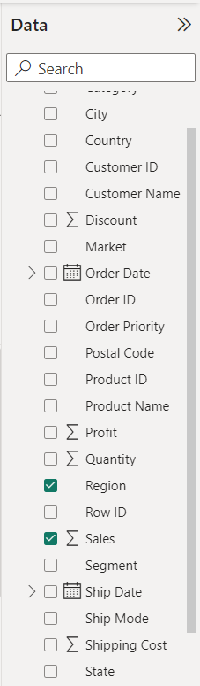
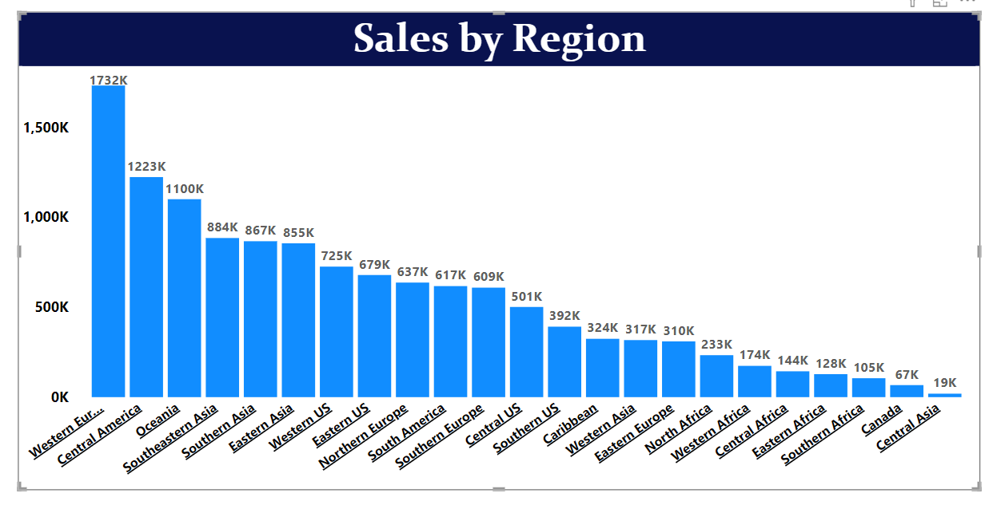
STACKED COLUMN CHART
Stacked column chart is a visualization that displays data in vertical columns, where each column represents a category or group, and the height of each segment within the column represents a subcategory or a specific data value.
For this kind of chart we need two types of data:
1 text (Less Distribution).
Ex –Region, Category, State
1 Numerical Data. Ex- Sales, Quantity

Slide 7
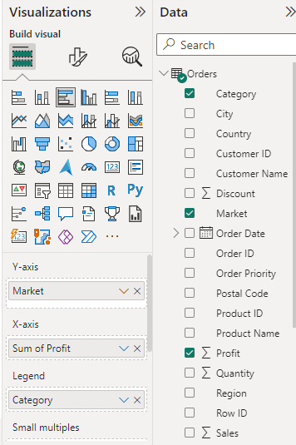
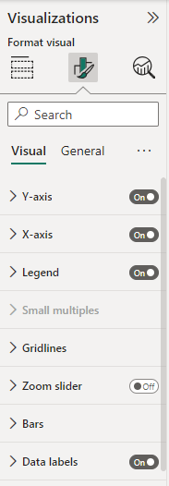
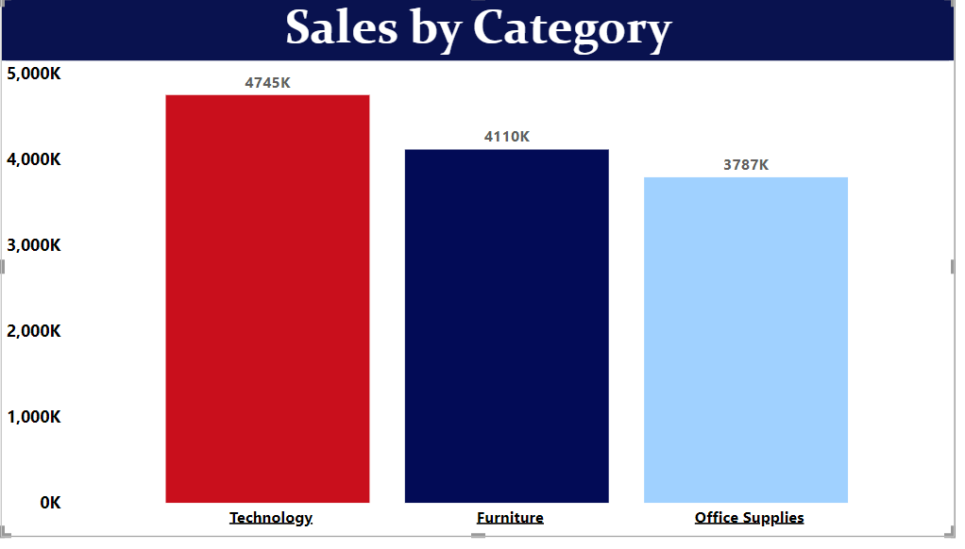
After the successful, creation of a Stacked Column chart in Power BI. We have multiple options to format it. For example, adding the title to the chart, changing the color, and position of the chart, and adding tooltips, bar colors, and data labels to the chart. Stacked column chart is interactive, allowing users to drill down into the data, filter, and explore different dimensions.
.
By- Shivani Prakash Naik

Slide 8
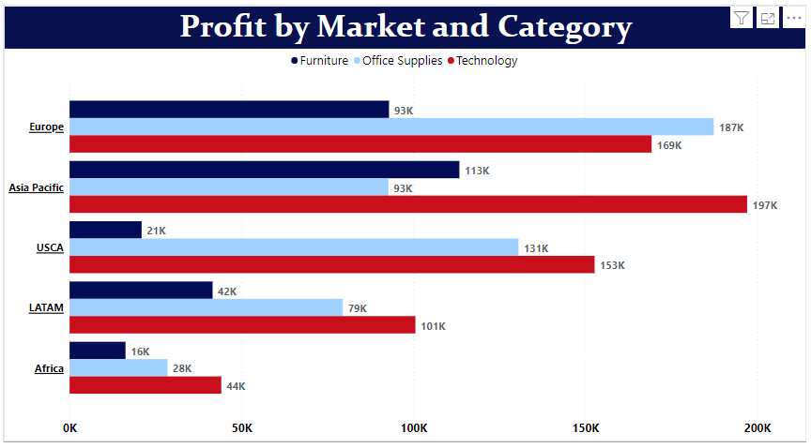
CLUSTERED BAR CHART
A clustered bar chart is a horizontal chart, which could present multiple bars in the form of a cluster. The horizontal bars basically group together, as they are under the same, y values.
For this kind of chart we need two types of data:
Text Data – 2 , with less distribution. For E.g., Market and Category, etc.
Numerical Data-1, e.g. Profit Sales

Slide 9
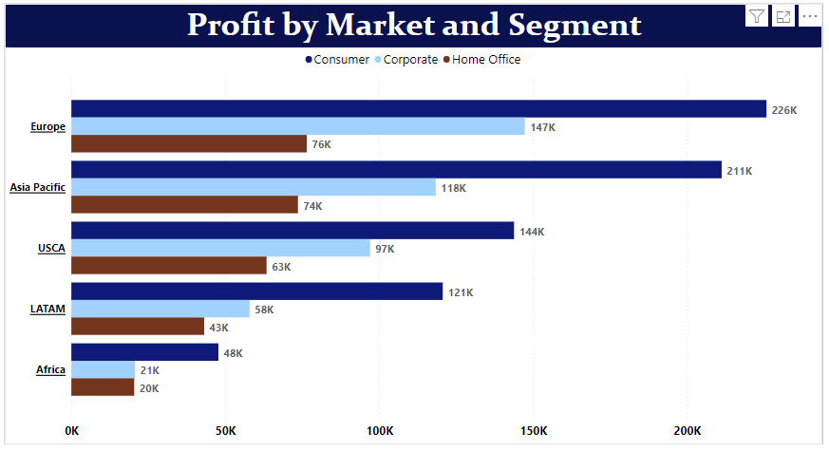
After the successful, creation of a clustered bar chart in Power BI. We have multiple options to format it. For example, adding the title to the chart, changing the color, and position of the chart, and adding tooltips, bar colors, and data labels to the chart.
By- Divya Rajawat

Slide 10
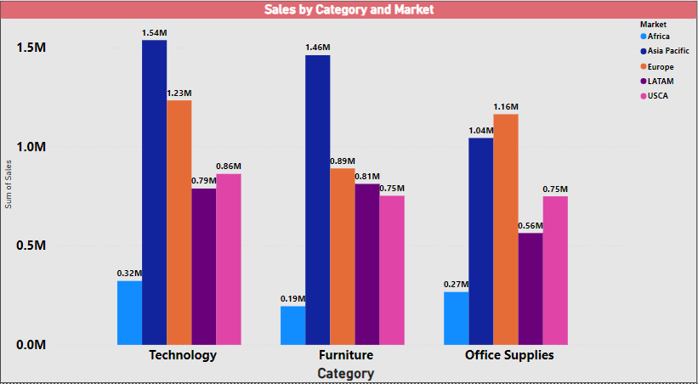
CLUSTERED COLUMN CHART
By- Gurunath Changle

Slide 11
100% STACKED BAR CHART
In a 100% stacked bar chart, the bars are split into colored bar segments placed on top of each other.
Each bar height is 100%, and the colored bar segments represent the components' relative contributions to the total bar.
For this type of chart we need:
2 Text Data (less distribution)-E.x- Region, Category,
1 Numerical Data (100% Distribution)-E.x - Sales

Slide 12
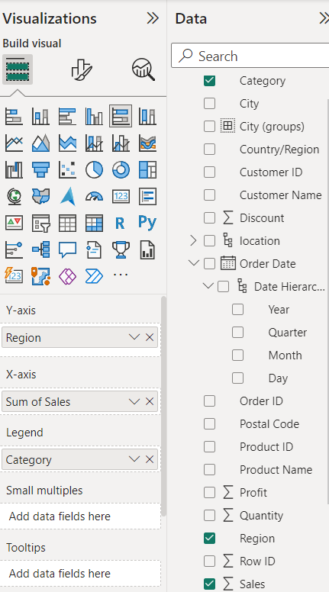
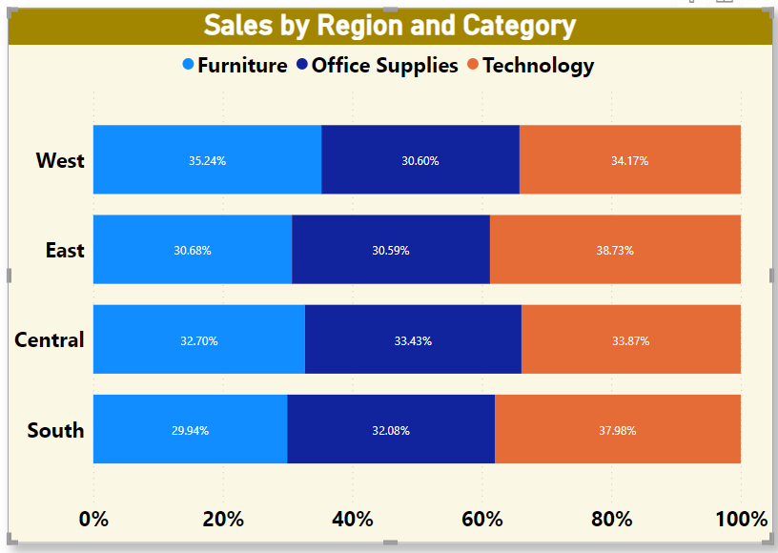
By- GAURI

Slide 13
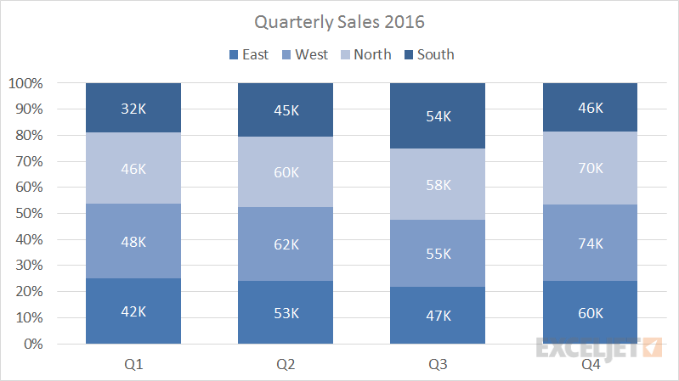
100% STACKED COLUMN CHART
100% stacked column chart is used to display relative percentage of multiple data series in Stacked columns, where the total (cumulative) of each Stacked columns always equals 100%.
Sample 100% Stacked Column Chart:
For this kind of chart we need two types of data:
2 Text (Less Distribution). E.x –Region, Category, Segment
1 Numerical Data (100% Distribution). E.x - Sales

Slide 14
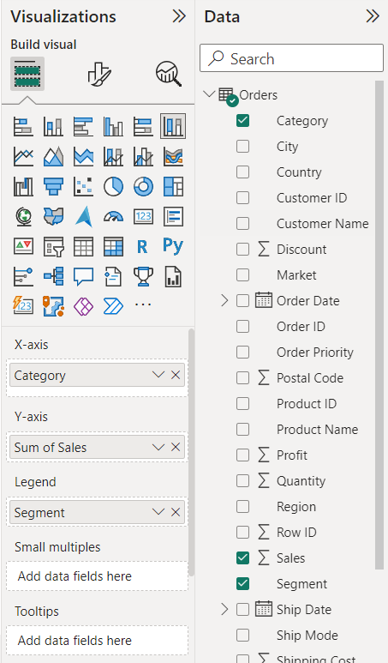
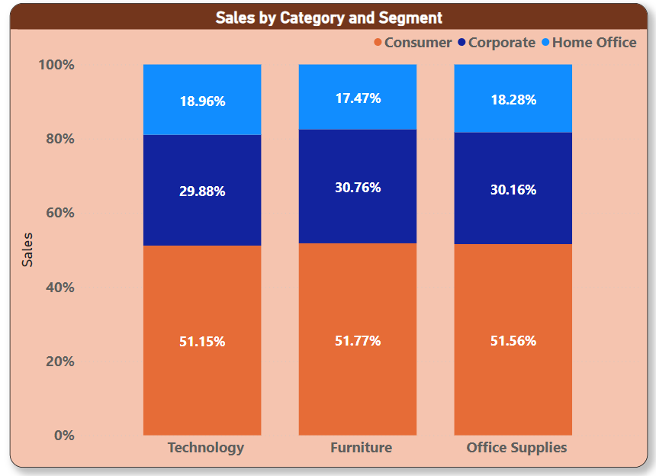
X-axis: Category
Y-axis: Sales
Legend: Segment
By- Rahul Iranna Sutar

Slide 15
SUMMARY
Stacked Bar Chart: A stacked bar chart is used to display the composition of a category by stacking multiple bars on top of each other. Each bar represents a different sub-category, and the length of each segment within the bar represents the proportion or value of that sub-category. It is useful for comparing the total values across different categories and their sub-categories
Stacked Column Chart: Similar to the stacked bar chart, the stacked column chart displays the composition of a category, but in a vertical layout. Each column represents a different sub-category, and the height of each segment within the column represents the proportion or value of that sub-category.
Clustered Bar Chart: A clustered bar chart compares multiple categories side by side, with each category having its own set of bars. It is useful for comparing values between different categories or sub-categories. The bars within each category are not stacked but displayed adjacent to each other.

Slide 16
. Clustered Column Chart: Similar to the clustered bar chart, the clustered column chart compares multiple categories side by side, but in a vertical layout. Each category has its own set of columns, and they are displayed adjacent to each other.
100% Stacked Bar Chart: A 100% stacked bar chart is similar to a stacked bar chart, but the length of each segment within the bar represents the percentage of that sub-category in relation to the whole category. It is useful for comparing the relative proportions of different sub-categories across categories.
100% Stacked Column Chart: Similar to the 100% stacked bar chart, the 100% stacked column chart represents the relative proportions of sub-categories within each category in a vertical layout. The height of each segment within the column represents the percentage of that sub-category in relation to the whole category.
By- Neha More

Slide 17
THANK YOU!!

